Slide 1
Dynamic Hi-C Analysis To Reveal Spatial and Temporal Chromatin Changes in B Cell Differentiation and EBV-Induced Resting B Lymphocytes (RBL) to Lymphoblastoid Cell Lines (LCL) Transformation
Jingjing Wu
2.14.2025

Slide 2
Epstein-Barr virus (EBV) can cause B-cell lymphomas
1. Epstein-Barr Virus (EBV) Overview
EBV is the first human DNA tumor virus discovered more than 50 years ago; causes ~200,000 cases of cancers every year.
2. EBV infection
Primary infection: Virus transits oropharyngeal epithelium → B cell compartment
Converts B cells → activated blasts for colonization
EBV-transformed lymphoblasts appear in infectious mononucleosis
3. Immune Evasion & Lifelong Infection
T/NK cells contain lymphoblast proliferation, but
Latently infected B cells act as lifelong viral reservoirs
Immunocompromised states (HIV, organ transplants) → Risk of fatal lymphoproliferative diseases & lymphomas
Notes:
In this study,
Epstein-Barr virus enhancers loop to cellular genes essential for LCL growth and survival
•EBV enhancers control expression of the cellular oncogene MYC
•EBV transcription factors drive MYC enhancer-promoter looping
•EBV transcription factors repress tumor suppressor CDKN2A/B through looping

Slide 3
EBV Transformation and Oncogenesis
1. In Vitro Transformation
EBV transforms resting B lymphocytes (RBLs) into lymphoblastoid cell lines (LCLs).
LCLs express type III EBV latency genes
2. In Vivo Immune Response
Normal immune system removes type III EBV latency program-expressing cells.
When the immune system is impaired (e.g., transplant recipients, AIDS patients): these cells can develop into lymphoproliferative diseases or lymphomas.
3. LCLs in EBV Research
LCLs provide a useful model to study EBV-driven oncogenesis.
Understanding EBV-mediated transformation can: Enhance insights into EBV pathogenesis; Help identify potential therapeutic targets.
Notes:
In this study,
Epstein-Barr virus enhancers loop to cellular genes essential for LCL growth and survival
•EBV enhancers control expression of the cellular oncogene MYC
•EBV transcription factors drive MYC enhancer-promoter looping
•EBV transcription factors repress tumor suppressor CDKN2A/B through looping

Slide 4
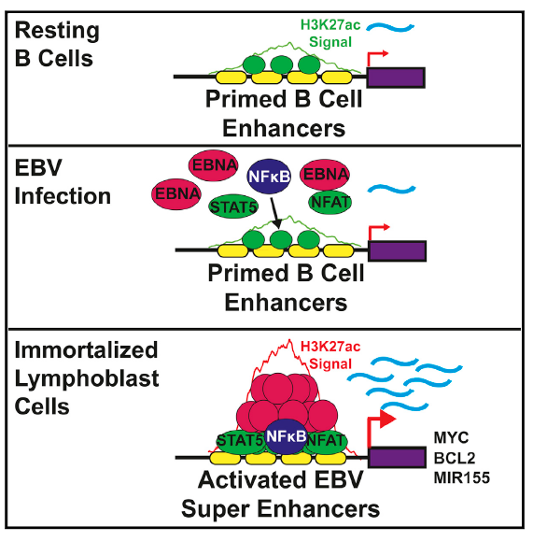
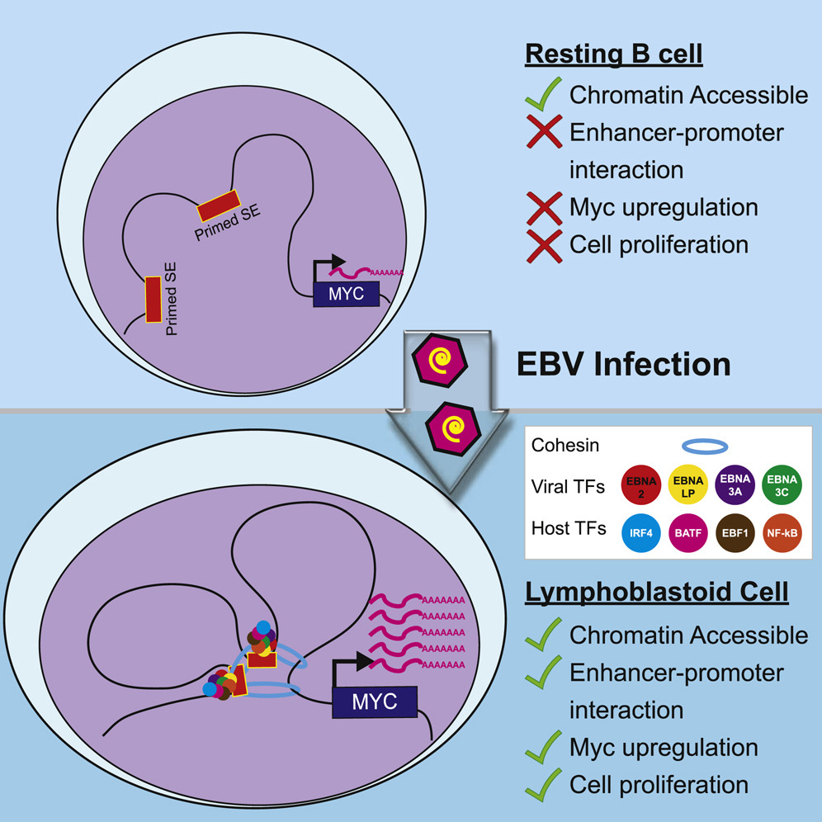
LCLs is a useful model for studying EBV-mediated B-lymphoid oncogenesis
Enhancers upregulate transcription independent of linear location, distance, and orientation. Distant enhancers regulate transcription by looping to their direct target genes. The 3D genome spatial juxtaposition of enhancer and promoter DNA allow transcription machinery assembled on enhancers to contact basal TFs on promoters to enable formation of higher-order complexes and coordinately activate cell gene expression
LCLs models: primary human resting B lymphocytes (RBLs) were infected with B95.8 EBV for 28 days
Based on this model, evidence suggests that Epstein-Barr virus (EBV) controls lymphocyte growth by globally reorganizing host chromatin architecture, facilitating the expression of key oncogenes.
This motivates a study on chromosome structural changed during RBLs to LCLs transition
Cell Host & Microbiome 2015: Epstein-Barr Virus Oncoprotein Super-enhancers Control B Cell Growth
Epstein-Barr virus transcription factors and virus activated NF-kB subunits converge into super-enhancers in lymphoblastoid cells to govern key oncogene expression and cause continuous cell growth.
Cell Host & Microbiome 2017: The Epstein-Barr Virus Regulome in Lymphoblastoid Cells
EBV infection reprograms the host chromatin architecture to activate oncogenes like MYC and drive the proliferation of B cells into LCLs.
Notes:
In this study,
Epstein-Barr virus enhancers loop to cellular genes essential for LCL growth and survival
•EBV enhancers control expression of the cellular oncogene MYC
•EBV transcription factors drive MYC enhancer-promoter looping
•EBV transcription factors repress tumor suppressor CDKN2A/B through looping

Slide 5
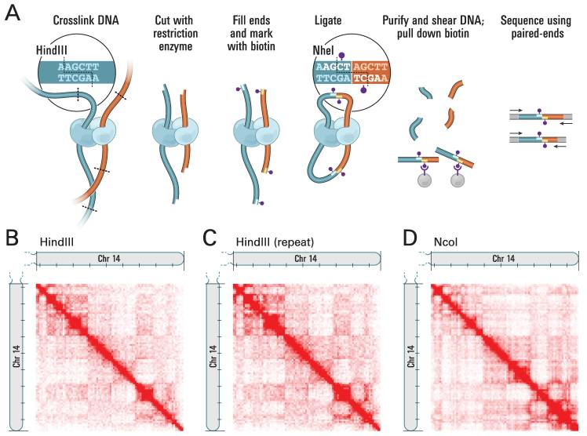
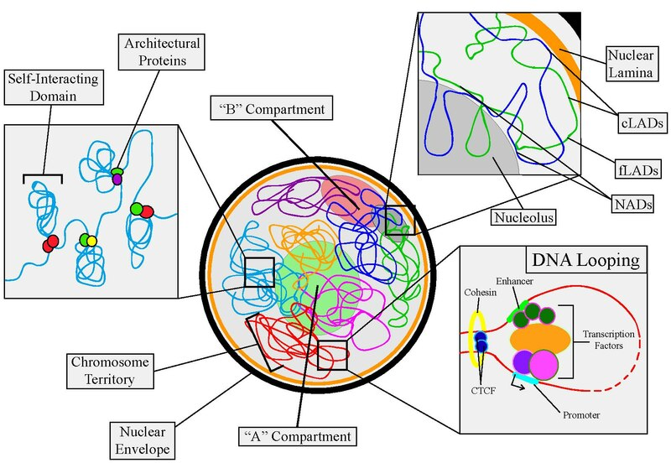
Chromosome structural features offer insights into EBV-mediated B-lymphoid oncogenesis
To accommodate the small size of the nucleus, the host genome is packaged in extremely complex, yet ordered patterns.
Host DNA is packaged in a way that remote enhancers and their direct target genes can communicate rapidly and efficiently, looping out many kilobases of DNA between them.
3D genome interactions can be assessed using chromatin conformation capture followed by deep sequencing (Hi-C), and subsequently identifying the interaction frequencies between genomic loci.
Science 2010: Comprehensive mapping of long range interactions reveals folding principles of the human genome
Notes:
Science 2010: Comprehensive mapping of long range interactions reveals folding principles of the human genome

Slide 6
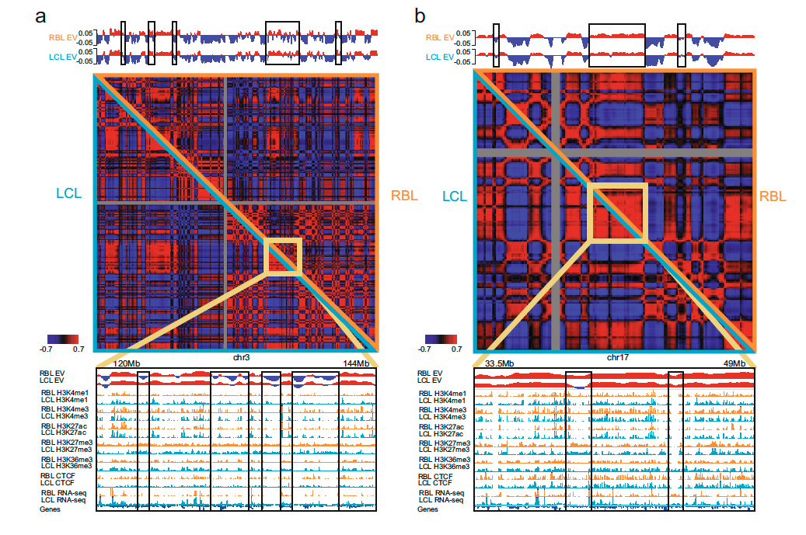
Chromosome structural features offer insights into EBV-mediated B-lymphoid oncogenesis
Xiang and etc. analysis Hi-C data of healthy donor RBL and LCL (4 weeks after EBV infection)
Hi-C data was incorporated with H3K4me3 ChIP-seq data: the genome can be divided into transcriptionally active and repressed compartments, A and B compartments.
A and B compartment switch was identified globally.
Nature Communication 2023: A DNA tumor virus globally reprograms host 3D genome architecture to achieve immortal growth
Notes:
In Figure 1 of the paper, an overlay of ChIP-seq data (for histone modifications and protein markers like H3K4me1, H3K4me3, H3K27ac, H3K36me3, and CTCF) along with RNA-seq data is combined with Hi-C data to provide a comprehensive view of chromatin structure and gene expression.
Here's how the data types are typically used together in this figure:
Hi-C Data:
Hi-C maps show the 3D structure of the genome by measuring interactions between different loci of the genome, helping to define the spatial organization. The resulting contact map is analyzed to identify A and B compartments, and also the long-range chromatin loops that may be important for gene regulation and interaction. This data shows how different regions of the genome physically interact with each other.
ChIP-seq Data:
Histone Modifications:
H3K4me1: Associated with enhancers, often found in regions that are transcriptionally active or primed for activation.
H3K4me3: Typically marks active promoters, playing a role in initiating transcription.
H3K27ac: A mark of active enhancers and transcriptionally active chromatin, often used to identify active regulatory regions.
H3K36me3: Found in actively transcribed genes, marking gene bodies and related to RNA polymerase II elongation.
CTCF: A transcription factor that binds insulator regions and plays a role in the 3D genome architecture, often used to identify domain boundaries and looping interactions.
RNA-seq:
Provides information about gene expression by measuring the transcripts in cells. It is used here to correlate gene activity with chromatin marks (like H3K4me3 for promoters and H3K27ac for enhancers), and to assess how these marks affect transcription.
How the overlay works:
The Hi-C map shows the large-scale structure (compartments, loops, and interactions).
The ChIP-seq tracks for histone marks (H3K4me1, H3K4me3, H3K27ac, H3K36me3) and CTCF are overlaid on this contact map to help interpret how chromatin features (like active promoters and enhancers) correlate with regions of the genome that interact with each other.
RNA-seq data is overlaid to indicate which genes are expressed and to examine whether gene expression correlates with the chromatin marks and the physical interactions observed in Hi-C.
The goal of this overlay:
The overlay of these data types allows researchers to integrate 3D structural data (from Hi-C) with epigenetic (from ChIP-seq) and transcriptional data (from RNA-seq). This comprehensive approach enables:
Understanding how chromatin modifications and transcription factors shape the 3D genome.
Identifying how genomic regions interact in three-dimensional space and how these interactions might regulate gene expression.
Visualizing how changes in chromatin structure (due to EBV infection, for instance) could lead to altered gene expression in lymphoblastoid cell lines (LCLs).

Slide 7
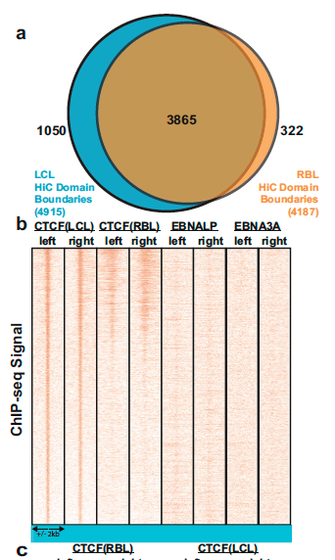
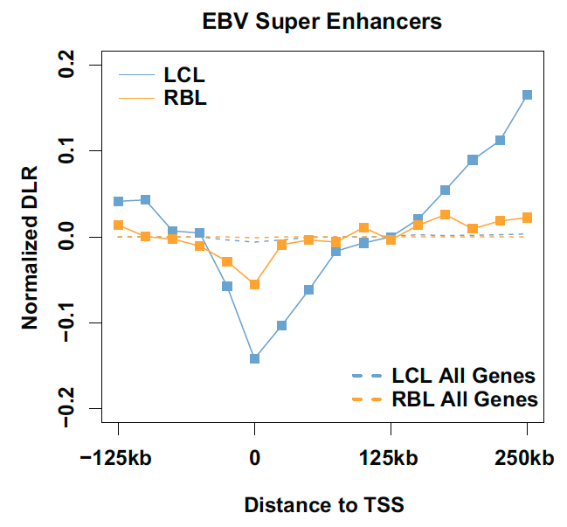
Chromosome structural features offer insights into EBV-mediated B-lymphoid oncogenesis
The mechanism through which EBV contributes to 3D genome structure changes was further investigated by focusing on contact domain boundaries, and new contact domain boundary was identified.
Genome reorganization around EBV-super enhancers were examined. It was found in creased genomic interactions in LCLs around ESEs, compared with RBLS
Positive correlation: If regions of the genome with more interactions (as represented by the eigenvector) also show high H3K4me3 levels, it suggests that these regions are active chromatin. These regions would typically be assigned positive eigenvector values and correspond to A compartments.Negative correlation: If regions with more interactions show low H3K4me3 levels, it suggests that these regions are inactive chromatin. These regions would typically be assigned negative eigenvector values and correspond to B compartments.
Nature Communication 2023: A DNA tumor virus globally reprograms host 3D genome architecture to achieve immortal growth
Notes:
1. Contact Domain Boundaries Define Chromatin Structure:
Contact domains are large regions of the genome that interact more frequently with each other than with regions outside the domain. These domains represent functional chromatin territories that are generally associated with either active or repressed chromatin.
Contact domain boundaries (often marked by specific proteins like CTCF) separate one domain from another. These boundaries are crucial for maintaining the integrity of chromatin domains and ensuring proper regulation of genes.
2. Role in Genome Organization:
Boundaries act as insulators that control chromatin interactions. They prevent regions from interacting inappropriately with each other, thus maintaining the functional compartmentalization of the genome. For example, they help prevent enhancer-promoter interactions from crossing into the wrong chromatin region.
These boundaries are structural features of the genome, and understanding them helps clarify how chromatin is organized within the nucleus in three-dimensional space.
3. Link to Gene Regulation:
The presence of contact domain boundaries is linked to the regulation of gene expression. In particular, the CTCF protein, which is often found at these boundaries, is involved in both maintaining these boundaries and regulating transcription by preventing inappropriate interactions between different chromatin regions.
When studying EBV infection and its effects on the genome, the authors wanted to understand how EBV might affect chromatin architecture and whether it alters the positioning of these boundaries, which in turn could impact gene expression and cellular transformation.
4. Changes in Contact Domain Boundaries Can Indicate Disease Processes:
In the case of EBV-induced transformation (e.g., in the formation of lymphoblastoid cell lines (LCLs)), studying the changes in contact domain boundaries can provide insights into how viral infection rewires the host genome. These changes may contribute to immortalization and proliferation of infected cells, which are key features of cancerous transformations.
By focusing on the boundaries, the authors are able to pinpoint where structural changes are occurring in the genome, which may also indicate how EBV infection alters the normal regulatory mechanisms of the host genome.
5. Boundary Regions Are Associated with Specific Histone Marks:
The authors also focus on these boundaries because they are associated with specific epigenetic markers (like H3K4me3, CTCF, and others). These markers can be used to track whether chromatin regions are in an active or repressed state, providing further insights into how viral infection might impact gene expression and chromatin remodeling.
By examining these regions in conjunction with Hi-C data, the authors can understand how chromatin interactions change across different stages of EBV infection, providing a more complete picture of how the virus affects genome architecture and gene regulation.
6. Insights into 3D Genome Reorganization:
Since Hi-C data captures the 3D structure of the genome, focusing on contact domain boundaries allows the authors to directly observe how the 3D genome is altered in response to EBV infection.
Understanding where contact domains are formed and how they change can provide insights into how the virus reprograms the chromatin in order to drive cell proliferation and transformation, which are key steps in viral oncogenesis.

Slide 8
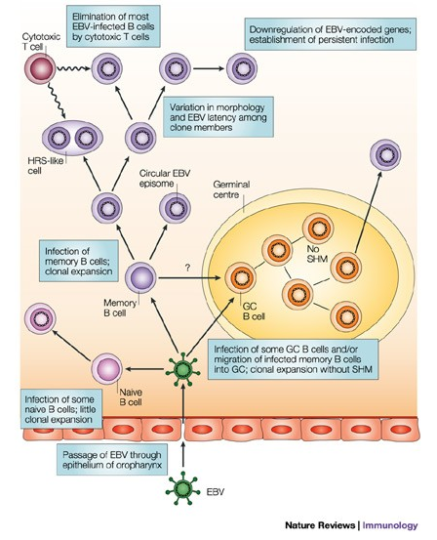
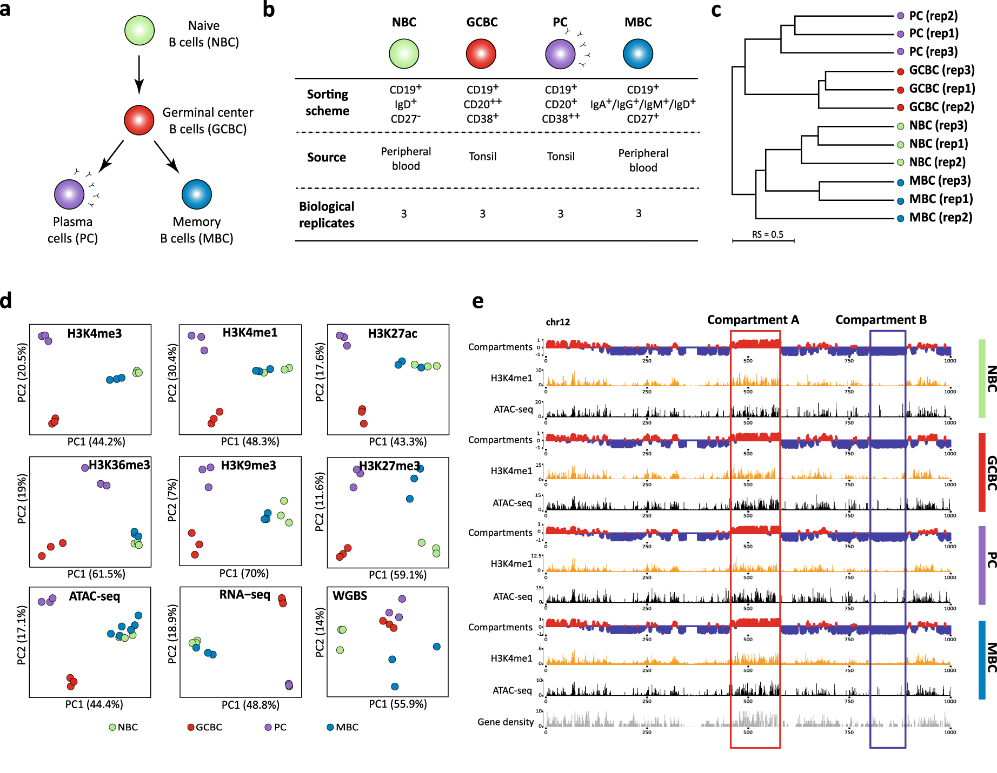
Naïve B cells (NBs)
Germinal Center B cells (GCBCs)
Plasma cells (PCs)
Memory B cells (MBCs)
However, in real life scenario
3D genome interactions are extensively modulated during normal B cell differentiation
Nature Communication 2021: Dynamics of genome architecture and chromatin function during human B cell differentiation and neoplastic transformation
Nature Review Immunology 2003: B cells under influence: transformation of B cells by Epstein–Barr virus
Notes:
1. Contact Domain Boundaries Define Chromatin Structure:
Contact domains are large regions of the genome that interact more frequently with each other than with regions outside the domain. These domains represent functional chromatin territories that are generally associated with either active or repressed chromatin.
Contact domain boundaries (often marked by specific proteins like CTCF) separate one domain from another. These boundaries are crucial for maintaining the integrity of chromatin domains and ensuring proper regulation of genes.
2. Role in Genome Organization:
Boundaries act as insulators that control chromatin interactions. They prevent regions from interacting inappropriately with each other, thus maintaining the functional compartmentalization of the genome. For example, they help prevent enhancer-promoter interactions from crossing into the wrong chromatin region.
These boundaries are structural features of the genome, and understanding them helps clarify how chromatin is organized within the nucleus in three-dimensional space.
3. Link to Gene Regulation:
The presence of contact domain boundaries is linked to the regulation of gene expression. In particular, the CTCF protein, which is often found at these boundaries, is involved in both maintaining these boundaries and regulating transcription by preventing inappropriate interactions between different chromatin regions.
When studying EBV infection and its effects on the genome, the authors wanted to understand how EBV might affect chromatin architecture and whether it alters the positioning of these boundaries, which in turn could impact gene expression and cellular transformation.
4. Changes in Contact Domain Boundaries Can Indicate Disease Processes:
In the case of EBV-induced transformation (e.g., in the formation of lymphoblastoid cell lines (LCLs)), studying the changes in contact domain boundaries can provide insights into how viral infection rewires the host genome. These changes may contribute to immortalization and proliferation of infected cells, which are key features of cancerous transformations.
By focusing on the boundaries, the authors are able to pinpoint where structural changes are occurring in the genome, which may also indicate how EBV infection alters the normal regulatory mechanisms of the host genome.
5. Boundary Regions Are Associated with Specific Histone Marks:
The authors also focus on these boundaries because they are associated with specific epigenetic markers (like H3K4me3, CTCF, and others). These markers can be used to track whether chromatin regions are in an active or repressed state, providing further insights into how viral infection might impact gene expression and chromatin remodeling.
By examining these regions in conjunction with Hi-C data, the authors can understand how chromatin interactions change across different stages of EBV infection, providing a more complete picture of how the virus affects genome architecture and gene regulation.
6. Insights into 3D Genome Reorganization:
Since Hi-C data captures the 3D structure of the genome, focusing on contact domain boundaries allows the authors to directly observe how the 3D genome is altered in response to EBV infection.
Understanding where contact domains are formed and how they change can provide insights into how the virus reprograms the chromatin in order to drive cell proliferation and transformation, which are key steps in viral oncogenesis.

Slide 9
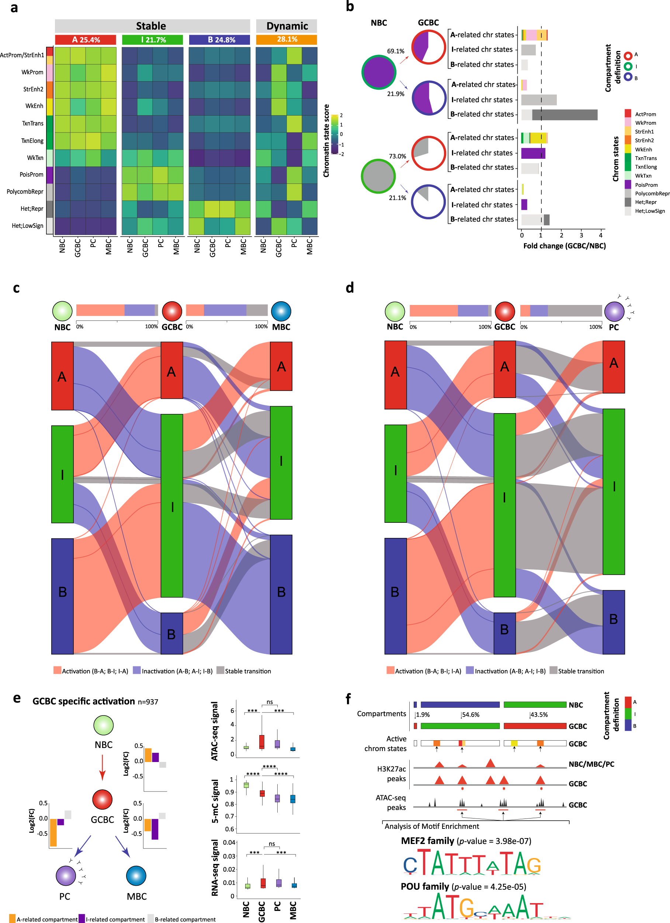
However, in real life scenario
Nature Communication 2021: Dynamics of genome architecture and chromatin function during human B cell differentiation and neoplastic transformation
Notes:
1. Contact Domain Boundaries Define Chromatin Structure:
Contact domains are large regions of the genome that interact more frequently with each other than with regions outside the domain. These domains represent functional chromatin territories that are generally associated with either active or repressed chromatin.
Contact domain boundaries (often marked by specific proteins like CTCF) separate one domain from another. These boundaries are crucial for maintaining the integrity of chromatin domains and ensuring proper regulation of genes.
2. Role in Genome Organization:
Boundaries act as insulators that control chromatin interactions. They prevent regions from interacting inappropriately with each other, thus maintaining the functional compartmentalization of the genome. For example, they help prevent enhancer-promoter interactions from crossing into the wrong chromatin region.
These boundaries are structural features of the genome, and understanding them helps clarify how chromatin is organized within the nucleus in three-dimensional space.
3. Link to Gene Regulation:
The presence of contact domain boundaries is linked to the regulation of gene expression. In particular, the CTCF protein, which is often found at these boundaries, is involved in both maintaining these boundaries and regulating transcription by preventing inappropriate interactions between different chromatin regions.
When studying EBV infection and its effects on the genome, the authors wanted to understand how EBV might affect chromatin architecture and whether it alters the positioning of these boundaries, which in turn could impact gene expression and cellular transformation.
4. Changes in Contact Domain Boundaries Can Indicate Disease Processes:
In the case of EBV-induced transformation (e.g., in the formation of lymphoblastoid cell lines (LCLs)), studying the changes in contact domain boundaries can provide insights into how viral infection rewires the host genome. These changes may contribute to immortalization and proliferation of infected cells, which are key features of cancerous transformations.
By focusing on the boundaries, the authors are able to pinpoint where structural changes are occurring in the genome, which may also indicate how EBV infection alters the normal regulatory mechanisms of the host genome.
5. Boundary Regions Are Associated with Specific Histone Marks:
The authors also focus on these boundaries because they are associated with specific epigenetic markers (like H3K4me3, CTCF, and others). These markers can be used to track whether chromatin regions are in an active or repressed state, providing further insights into how viral infection might impact gene expression and chromatin remodeling.
By examining these regions in conjunction with Hi-C data, the authors can understand how chromatin interactions change across different stages of EBV infection, providing a more complete picture of how the virus affects genome architecture and gene regulation.
6. Insights into 3D Genome Reorganization:
Since Hi-C data captures the 3D structure of the genome, focusing on contact domain boundaries allows the authors to directly observe how the 3D genome is altered in response to EBV infection.
Understanding where contact domains are formed and how they change can provide insights into how the virus reprograms the chromatin in order to drive cell proliferation and transformation, which are key steps in viral oncogenesis.

Slide 10
To solve this problem
We need to identify EBV-specific chromatin changes that mimic or diverge from natural B cell differentiation.
Eg.
Chromatin Comparison Across B Cell Stages: Map compartment shifts and identify structural drivers (e.g., enhancers, boundary changes) during differentiation from NBCs to PCs.
Contrast EBV-Specific Chromatin Changes: Identify and contrast EBV-specific structural changes that mimic or diverge from natural B cell differentiation.
EBV-Driven Reorganization: Analyze the chromatin changes specific to EBV-mediated transformation from RBLs to LCLs by excluding false positive signals, focusing on enhancer remodeling and domain dynamics.
Notes:
Epstein–Barr virus (EBV) enters the lymphoid tissue of the oropharynx and infects B cells. Molecular analysis of EBV-infected B cells in tonsils of patients with infectious mononucleosis indicated that EBV mainly infects germinal-centre and/or memory B cells, but also some naive B cells. Clonal expansion of infected B cells in the interfollicular region is (largely) restricted to germinal-centre/memory B cells and is not accompanied by somatic hypermutation (SHM). Occasionally, EBV-positive B cells are detected in the germinal centre. These cells also undergo clonal expansion, but they do not participate in a normal germinal-centre reaction. It is unclear whether EBV directly infects germinal-centre B cells, or whether EBV-infected memory B cells enter germinal centres. Members of clones of EBV-positive B cells in the interfollicular region show variation in morphology — small cells, blasts and Hodgkin and Reed–Sternberg (HRS)-like cells — and presumably also EBV-gene expression pattern. Most EBV-positive B cells are eliminated by cytotoxic T cells. A few EBV-positive B cells downregulate the expression of EBV-encoded genes, so that they cannot be detected by T cells, and establish the long-term reservoir of EBV-positive cells. GC, germinal centre.

Slide 11
Thank you so much for listening!

Slide 12
Background
1. Evidence suggests that Epstein-Barr virus (EBV) controls lymphocyte growth by globally reorganizing host chromatin architecture, facilitating the expression of key oncogenes.
2. Normal human B cell differentiation and the EBV-induced transformation of resting B lymphocytes (RBLs) into lymphoblastoid cell lines (LCLs) serve as ideal models to investigate EBV-specific alterations in 3D genome architecture and uncover how EBV reorganizes the host genome.
3. What has been done in Xiang’s study
4. This project aims to identify EBV-specific chromatin changes that mimic or diverge from natural B cell differentiation, shedding light on the mechanisms underlying DNA virus-induced oncogenesis.

Slide 13
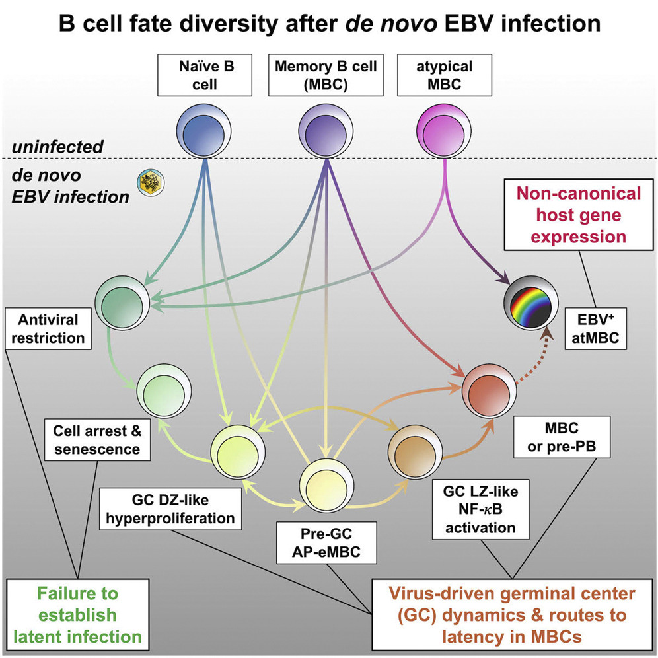
To solve this problem
We need to identify EBV-specific chromatin changes that mimic or diverge from natural B cell differentiation
B cells are activated upon antigen encounter and finally get differentiated into Plasma cell or memory cell.
Cell Reports 2022: Time-resolved transcriptomes reveal diverse B cell fate trajectories in the early response to Epstein-Barr virus infection
Notes:
Epstein–Barr virus (EBV) enters the lymphoid tissue of the oropharynx and infects B cells. Molecular analysis of EBV-infected B cells in tonsils of patients with infectious mononucleosis indicated that EBV mainly infects germinal-centre and/or memory B cells, but also some naive B cells. Clonal expansion of infected B cells in the interfollicular region is (largely) restricted to germinal-centre/memory B cells and is not accompanied by somatic hypermutation (SHM). Occasionally, EBV-positive B cells are detected in the germinal centre. These cells also undergo clonal expansion, but they do not participate in a normal germinal-centre reaction. It is unclear whether EBV directly infects germinal-centre B cells, or whether EBV-infected memory B cells enter germinal centres. Members of clones of EBV-positive B cells in the interfollicular region show variation in morphology — small cells, blasts and Hodgkin and Reed–Sternberg (HRS)-like cells — and presumably also EBV-gene expression pattern. Most EBV-positive B cells are eliminated by cytotoxic T cells. A few EBV-positive B cells downregulate the expression of EBV-encoded genes, so that they cannot be detected by T cells, and establish the long-term reservoir of EBV-positive cells. GC, germinal centre.

Slide 14
Future Direction
Notes:
Epstein–Barr virus (EBV) enters the lymphoid tissue of the oropharynx and infects B cells. Molecular analysis of EBV-infected B cells in tonsils of patients with infectious mononucleosis indicated that EBV mainly infects germinal-centre and/or memory B cells, but also some naive B cells. Clonal expansion of infected B cells in the interfollicular region is (largely) restricted to germinal-centre/memory B cells and is not accompanied by somatic hypermutation (SHM). Occasionally, EBV-positive B cells are detected in the germinal centre. These cells also undergo clonal expansion, but they do not participate in a normal germinal-centre reaction. It is unclear whether EBV directly infects germinal-centre B cells, or whether EBV-infected memory B cells enter germinal centres. Members of clones of EBV-positive B cells in the interfollicular region show variation in morphology — small cells, blasts and Hodgkin and Reed–Sternberg (HRS)-like cells — and presumably also EBV-gene expression pattern. Most EBV-positive B cells are eliminated by cytotoxic T cells. A few EBV-positive B cells downregulate the expression of EBV-encoded genes, so that they cannot be detected by T cells, and establish the long-term reservoir of EBV-positive cells. GC, germinal centre.

Slide 15
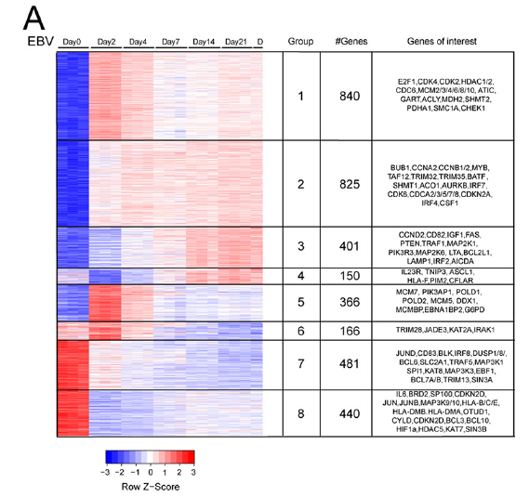
EBV immortalization of resting B lymphocytes (RBLs) is a useful model system to study EBV oncogenesis
Enhancers upregulate transcription independent of linear location, distance, and orientation. Distant enhancers regulate transcription by looping to their direct target genes. The 3D genome spatial juxtaposition of enhancer and promoter DNA allow transcription machinery assembled on enhancers to contact basal TFs on promoters to enable formation of higher-order complexes and coordinately activate cell gene expression
1. EBV Transformation in Vitro
EBV transforms resting B lymphocytes (RBLs) → proliferating LCLs (Lymphoblastoid Cell Lines)
LCLs express the same viral genes as EBV-associated lymphomas
Key viral genes: 6 EBV Nuclear Antigens (EBNAs), 3 Latent Membrane Proteins (LMPs), Multiple microRNAs
2. Studies based on LCL models
primary human resting B lymphocytes (RBLs) were infected with B95.8 EBV for 0, 2, 4, 7, 14, 21, and 28 days, and poly(A) plus RNAs were analyzed by transcriptome sequencing (RNA-seq).
Epstein-Barr virus (EBV) immortalization of resting B lymphocytes (RBLs) is a useful model system to study EBV oncogenesis
Notes:
In this study,
Epstein-Barr virus enhancers loop to cellular genes essential for LCL growth and survival
•EBV enhancers control expression of the cellular oncogene MYC
•EBV transcription factors drive MYC enhancer-promoter looping
•EBV transcription factors repress tumor suppressor CDKN2A/B through looping

Slide 16
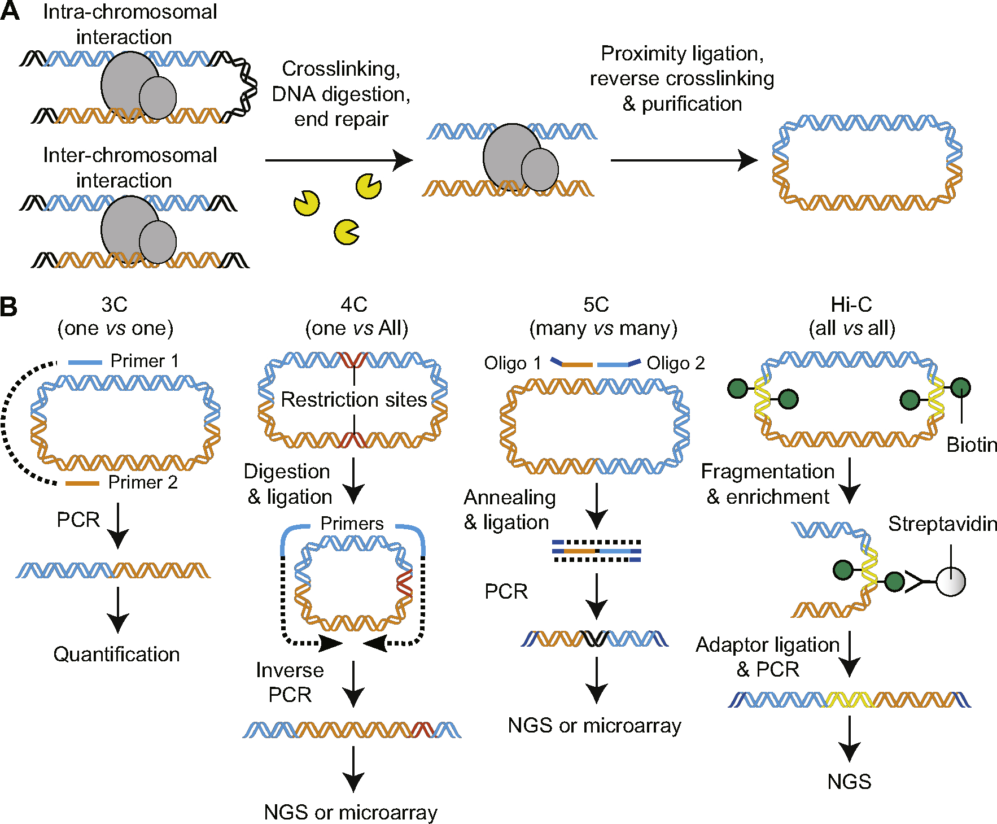
Nature Reviews Immunology 2003: B cells under influence: transformation of B cells by Epstein–Barr virus

